Slide 1
ICS 141 – Programming With Objects
Lecture 9 – Robert Jahn

Slide 2
Exception Handling

Slide 3
Terminology
Our Exceptions are just objects in Java. Each type of exception has its own class definition. ArithmeticException and NullPointerException are two examples of Java exception classes.
We ‘throw’ our exceptions. Note that this means we are deviating from normal program execution. Instead, we are jumping into the exception handling portion of the flow, which is mutually exclusive from the normal flow.

Slide 4
Terminology
We use try/catch blocks to handle these exceptions.
The try block is used to attempt to execute the code that you suspect may throw an exception.
The catch block contains the code used to handle the scenario in which the exception is thrown in the try block. Generally, we try to continue program execution or we elegantly terminate the program.

Slide 5
Declaring Exceptions
Every method must state the types of checked exceptions it might throw. This is known as declaring exceptions.
public void myMethod()
throws IOException
public void myMethod()
throws IOException, OtherException

Slide 6
Throwing Exceptions
When the program detects an error, the program can create an instance of an appropriate exception type and throw it. This is known as throwing an exception. Here is an example,
throw new TheException();
TheException ex = new TheException(); throw ex;

Slide 7
Throwing Exceptions Example
/** Set a new radius */
public void setRadius(double newRadius)
throws IllegalArgumentException {
if (newRadius >= 0)
radius = newRadius;
else
throw new IllegalArgumentException(
"Radius cannot be negative");
}

Slide 8
Catching Exceptions
try {
statements; // Statements that may throw exceptions
}
catch (Exception1 exVar1) {
handler for exception1;
}
catch (Exception2 exVar2) {
handler for exception2;
}
...
catch (ExceptionN exVar3) {
handler for exceptionN;
}

Slide 9
Exceptions
As we’ll see, Java has many types of different exceptions.
These correspond to the large amount of different errors that can occur in our programs.
We can even create our own custom exception classes.
Given this, the possibilities are endless.
Although there are many types of different exceptions, we’ll keep our focus to a few that seem to pop up frequently at this level.

Slide 10
Null Pointer Exception
This is one of the most important exceptions to consider.
Although you may not be aware, you likely have encountered this error, or exception, as you’ve programmed in the past.
Not just java, this is an error you’d consider in any imperative programming language.
Essentially, this error occurs when we have a reference variable that has not been set, or that it has been set to point to null.
On its own, this is not an issue…

Slide 11
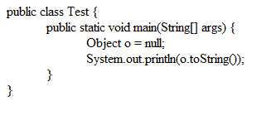
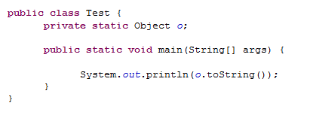
Null Pointer Exception
It is when we try to dereference this variable before actually setting it to point to something that we actually find the exception.

Slide 12
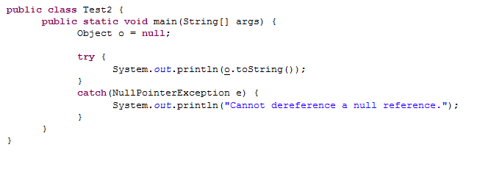
Null Pointer Exception
How do we fix this? We’ll use Java’s built-in exception handling system to fix this issue, and many similar issues we might encounter.

Slide 13
Interesting Point
This brings up an interesting point. In java, we can explicitly create and throw an exception as we saw.
However, in this previous example, the exception is implicitly created and thrown by the JVM.

Slide 14
Exercise #11a

Slide 15
Checked Exceptions vs. Unchecked Exceptions
RuntimeException, Error and their subclasses are known as unchecked exceptions. All other exceptions are known as checked exceptions, meaning that the compiler forces the programmer to check and deal with the exceptions. FileNotFoundException would be an example of a checked exception.

Slide 16
Unchecked Exceptions
In most cases, unchecked exceptions reflect programming logic errors that are not recoverable. For example, a NullPointerException is thrown if you access an object through a reference variable before an object is assigned to it; an IndexOutOfBoundsException is thrown if you access an element in an array outside the bounds of the array. These are the logic errors that should be corrected in the program. Unchecked exceptions can occur anywhere in the program. To avoid cumbersome overuse of try-catch blocks, Java does not mandate you to write code to catch unchecked exceptions.

Slide 17
Finally Clause
Sometimes, we want to execute certain bits of code regardless if an exception was thrown or not. We know that any of the code in the try block that occurs after an exception has been thrown will be skipped. Therefore, we cannot place this code in the try block.
Instead, we’d use the finally clause.
Java keyword. All lowercase.

Slide 18
The finally Clause
try {
statements;
}
catch(TheException ex) {
handling ex;
}
finally {
finalStatements;
}

Slide 19
Trace a Program Execution 1
animation
Suppose no exceptions in the statements
try {
statements;
}
catch(TheException ex) {
handling ex;
}
finally {
finalStatements;
}
Next statement;

Slide 20
Trace a Program Execution 1
animation
The final block is always executed
try {
statements;
}
catch(TheException ex) {
handling ex;
}
finally {
finalStatements;
}
Next statement;

Slide 21
Trace a Program Execution 1
animation
Next statement in the method is executed
try {
statements;
}
catch(TheException ex) {
handling ex;
}
finally {
finalStatements;
}
Next statement;

Slide 22
Trace a Program Execution 2
animation
try {
statement1;
statement2;
statement3;
}
catch(Exception1 ex) {
handling ex;
}
finally {
finalStatements;
}
Next statement;
Suppose an exception of type Exception1 is thrown in statement2

Slide 23
Trace a Program Execution 2
animation
try {
statement1;
statement2;
statement3;
}
catch(Exception1 ex) {
handling ex;
}
finally {
finalStatements;
}
Next statement;
The exception is handled.

Slide 24
Trace a Program Execution 2
animation
try {
statement1;
statement2;
statement3;
}
catch(Exception1 ex) {
handling ex;
}
finally {
finalStatements;
}
Next statement;
The final block is always executed.

Slide 25
Trace a Program Execution 2
animation
try {
statement1;
statement2;
statement3;
}
catch(Exception1 ex) {
handling ex;
}
finally {
finalStatements;
}
Next statement;
The next statement in the method is now executed.

Slide 26
Cautions When Using Exceptions
Exception handling separates error-handling code from normal programming tasks, thus making programs easier to read and to modify. Be aware, however, that exception handling usually requires more time and resources because it requires instantiating a new exception object, rolling back the call stack, and propagating the errors to the calling methods.

Slide 27
Exercise #11b

Slide 28
File I/O
We’ve seen we can gather input from the user in two ways.
Scanner objects linked to the command line.
GUI input with text fields.
Now we are going to look at a third way to grab input for our programs.
Java’s extensive file I/O library gives us the tools to effectively open files, parse the text within the file, generate some output, and send that output to the user, or even an output file.
We introduce this hand-in-hand with exception handling, as we are highly likely to run into exceptions when doing this work.

Slide 29
A Few Classes to Help with these Tasks.
Scanner
Will read in the file contents.
PrintWriter
Will write to a file.
File
Represents a file object. Helps us in opening/closing files of interest.
As we talked about last week, there are a few other classes we could use (BufferedReader and BufferedWriter for instance). However, these will be the simplest, so we’ll start with these.
We’ll also just work with .txt files for the time being.

Slide 30
The File Class
The File class is intended to provide an abstraction that deals with most of the machine-dependent complexities of files and path names in a machine-independent fashion. The filename is a string. The File class is a wrapper class for the file name and its directory path.

Slide 31
The File Class
For instance, consider one of the major differences between Unix and Windows operating systems.
In Unix, the file separator is the slash: /root/Bob/HW
In Windows, it is the backslash: \Users\Bob\HW
Changes such as these will be abstracted away by the File class. This way, we can approach solutions in way that is independent of the OS being used. This will also allow us to more generally use the same solution across different systems.

Slide 32
FILE Class

Slide 33
Syntax
Just as we’ve seen all along, creating a File object follows the same syntax.
We declare a reference variable and have it point to a new File object.
We’ll create the File object by passing it a String.
This String will be our pathname.
Note: The pathname must be seeable from the default directory.
In Eclipse, this is in the Eclipse project directory.
For those that use NetBeans, I assume that this is the same.

Slide 34
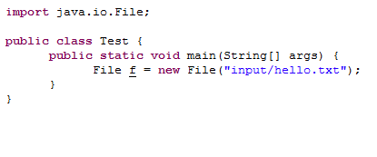
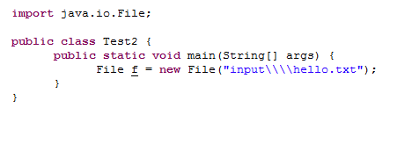
Syntax
Which is preferable?
For the sake of simplicity, the first version, the Unix version with the forward slash, would be preferable.
Note the complexity of the Windows version. We need 4 backslashes to represent a single backslash. This is because the backslash, in Java is an escape sequence (\n or \t for instance). However, it is also a special character in regular expressions. So, to get a single backslash to appear, we need 4 overall.

Slide 35
Text I/O
A File object encapsulates the properties of a file or a path, but does not contain the methods for reading/writing data from/to a file. In order to perform I/O, you need to create objects using appropriate Java I/O classes. The objects contain the methods for reading/writing data from/to a file. This section introduces how to read/write strings and numeric values from/to a text file using the Scanner and PrintWriter classes.

Slide 36
Reading Data Using Scanner

Slide 37
Scanner Syntax
Correct
Scanner input = new Scanner(new File(“scores.txt”));
Incorrect
Scanner input = new Scanner(“scores.txt”);

Slide 38
Reading from a File
Say we want to read in some data from a text file. Let’s say we know the form of this text file. It will have a person’s full name and score on each line.
John K Smith 90
Wilbur W Wright 85
Joanne T Smithers 95

Slide 39
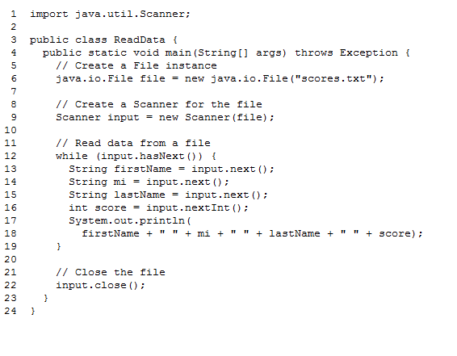
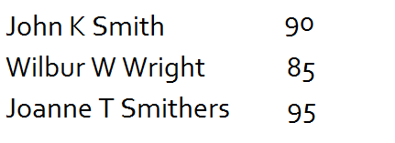
Reading from a File

Slide 40
Writing Data Using PrintWriter

Slide 41
Writing to a File
Suppose we want to write some text to a file. Specifically, we want to write a few names and integer values to a text file. Let’s go through a very basic example to see how we can write to a text file using Java’s File and PrintWriter classes.

Slide 42
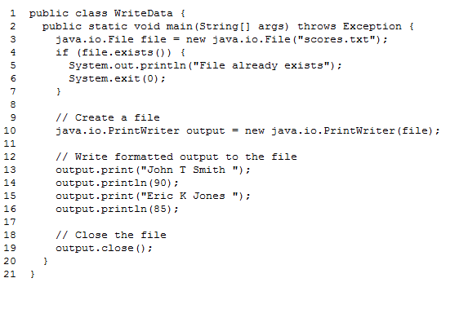
Writing to a File

Slide 43
Close Your Streams
We must always remember to close the streams to our files when we are done.
Otherwise, they’ll remain open after the program has ended.
This may lead to data corruption and a loss of resources.
Syntax
Input.close();
Output.close();

Slide 44
Exceptions
I mentioned early on that we introduce exceptions and file I/O together as they go hand-in-hand.
That is, whenever we are doing file I/O, we are bound to find some use from exceptions.
We will use them in two ways.
Whenever we try to open a file for reading.
When we try to scan in input from a file.

Slide 45
Open a File for Reading
Whenever we specify a file name for the Scanner class to open, there is always the possibility that the file does not exist. If this is the case, we’ll throw a FileNotFoundException.

Slide 46
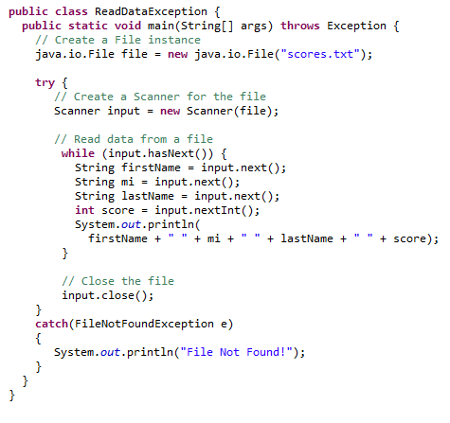
Open a File for Reading

Slide 47
What About Writing to a Non-Existent File?
In this case, we do not have to worry about exceptions
This is because Java will automatically create a file if it does not exist when we wish to write to a file.
If the file does exist, it will be overwritten.
Be careful!

Slide 48
Scanning in Input
We’ll also find it advantageous to use exception handling when parsing the actual contents of a file.
That is, when we expect an int, but get a double, we’ll throw an exception.
Exception handling allows us to easily recover from such an issue.

Slide 49
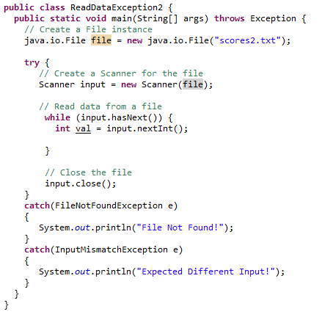
File I/O
This will work, but it is not entirely effective. What happens when we read a non-integer?
Let’s go over a small example in which we gather all integers in a file, discard any non-ints, and calculate the total sum of all integers.

Slide 50
Example
Say we have a txt file which holds a single student’s quiz scores. We want to write up a small program to total these scores. However, we have to be careful for bad input!
5
4
7
8
9
7
8
6
5g
7
4
7.7
5
6

Slide 51
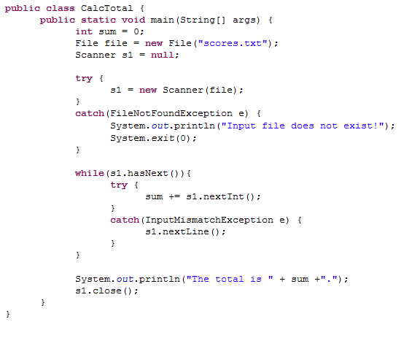
Solution

Slide 52
Assignment #9

Slide 53
Lab #6

